Slide 1


RELIANCE LTD.
Stock Analysis
Using Python Libraries such as Numpy, Pandas, Matlplotlib, Tensorflow, and Keras using LSTM Model.
By Vansh K Sharma & Tushar Parashar

Slide 2
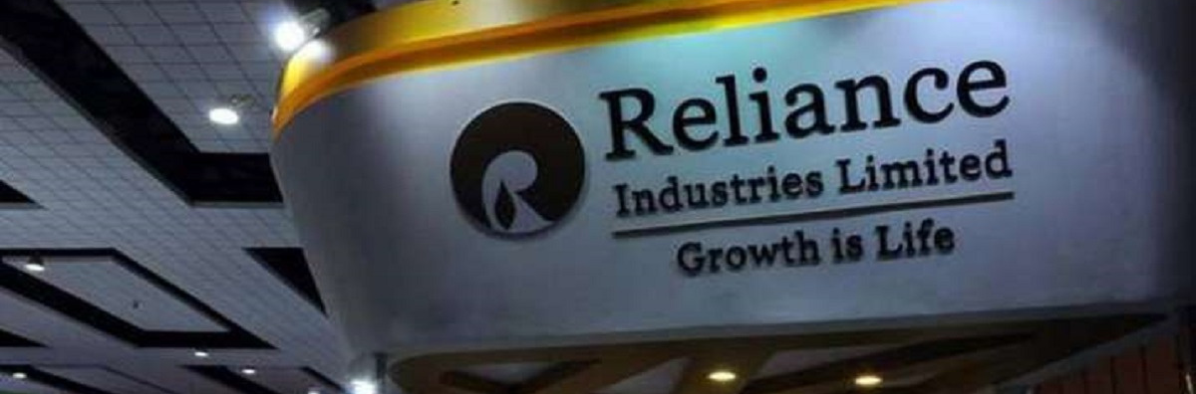
Company Name:
Date of Incorporation:
Business:
Reliance
08 May 1973
Energy, petrochemicals, natural gas, retail, telecommunications, mass media, and textiles.
Company Details
Authorized Capital:
Share Listing:
Paid-Up Capital:
It's a company limited by shares having an authorized capital of Rs 15,000.00 cr
The Company’s stock has been
listed on the Stock Exchange
since November,1977
Paid-up capital of Rs 6,765.35 cr as per MCA.

Slide 3


Overview
A Brief About the Problem
A dataset containing prices of Reliance stock from 1996 to 2020.
Contains volume, turnover, open, high, low, close prices of the stock.
This dataset is meant to be used for predicting the stock prices in future.

Slide 4
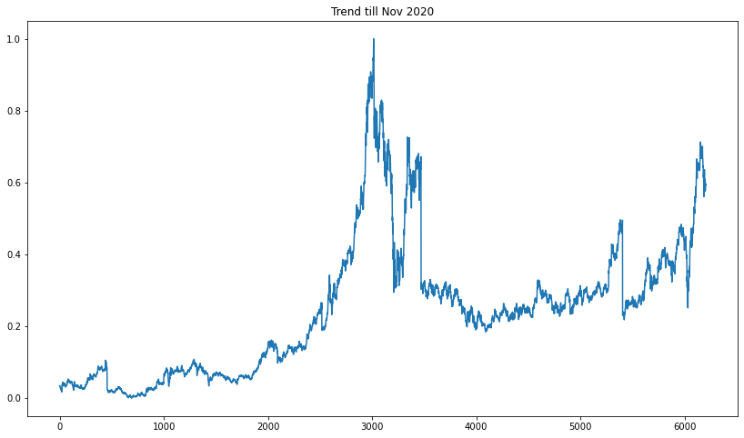

Trend from Jan 1996 till Nov 2020
Trend Function
Steep rise
Steep Fall
3000
6000

Slide 5
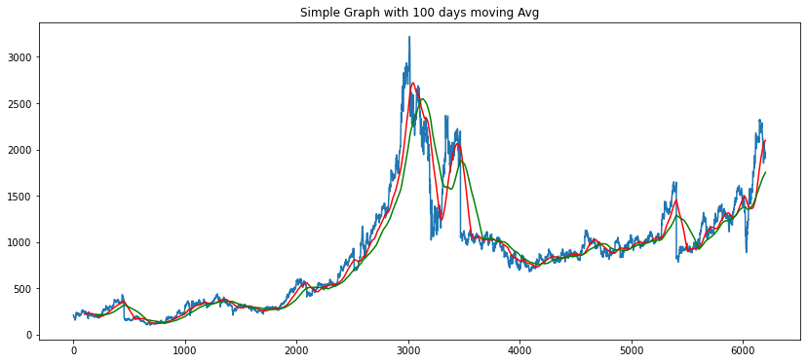
Buy?!
Simple Trend vs 100 days Moving Avg vs 200 Days Moving Avg
OR
Sell?!

Slide 6
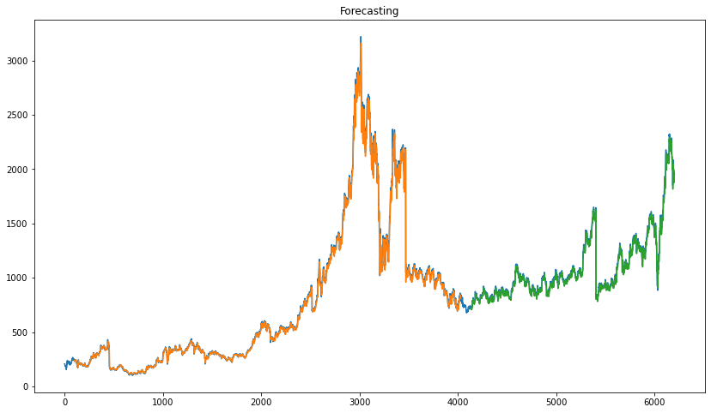
Forecasting Model Overlapping Real Data
Forecasting Model
Forecasting Model
Overlap

Slide 7
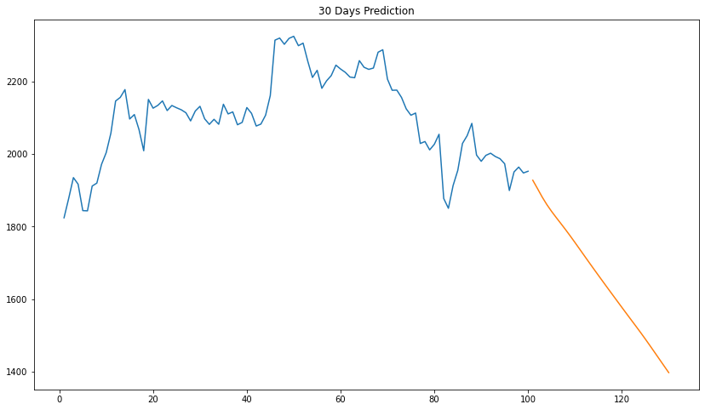
Prediction Model
30 Days Prediction Model

Slide 8
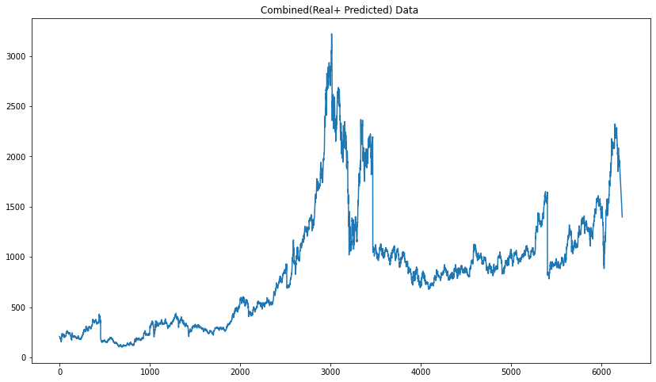
Predicted Data
Real + Predicted Data
Conclusion
Decrease

Slide 9
Thank You!
for listening us patiently.

